Slide 1
UNIVERSITY INSTITUTE OF COMPUTING
Bachelors of Computer Science
Project PPT
23SCR-304
BANKING MANAGMENT SYSTEM
An Overview
of Computing
&
Career Planning
Student Names: Franklin Francis
UIDs: 23BSC10079
Section/Group: 1/A
Supervisor Name: Parwan Signh
Designation: Professor
Project Presentation
DISCOVER . LEARN . EMPOWER

Slide 2

Table of Contents — Overview
Theory
Aim & Objective
Linked lists and core concepts.
Project purpose and learning goals.
Results & Outcomes
Methods & Code
Execution summary, learning outcomes, and future work.
Algorithm design, implementation, and sample code.

Slide 3

Aim
The aim is to design and implement a simple, efficient Banking Management System in C++ to perform creating, displaying, searching, deleting, depositing, and withdrawing from accounts using linked lists for dynamic data handling.

Slide 4

Objectives
1
Apply Data Structures
Use linked lists to manage dynamic customer records.
2
Interactive Console
Menu-driven app for add/delete/update operations.
3
Modular Programming
Separate functions like addAccount(), deleteAccount(), depositMoney().
4
Memory Management
Demonstrate allocation and deallocation using pointers.

Slide 5

Theory — Linked Lists
Linked lists enable dynamic memory allocation and flexible insertion/deletion by representing each account as a node with account details and a pointer to the next node.
Advantages
Disadvantages
Dynamic memory allocation
Sequential access only
Efficient insertion & deletion
Memory overhead for pointers
Flexible size management
Better memory utilization
Complex reverse traversal

Slide 6
Application in Banking
Account Storage
Search & Display
Memory Management
Dynamic handling of accounts and real-time updates for deposits and withdrawals.
Efficient traversal for searching and formatted tabular output.
Node deallocation ensures clean resource release on exit.

Slide 7

Implementation Highlights (Code)
Core structure and functions used in the system:
struct Account {
int account_number;
string name;
double balance;
string account_type;
Account* next;
};
Account* head = NULL;
int accountCounter = 1001;
Key Functions
add Account(name, type, initial_deposit)
display Accounts()
delete Account(account_number)
deposit Money(account_number, amount)
withdraw Money(account_number, amount)
Search Account(account_number/Name)

Slide 8
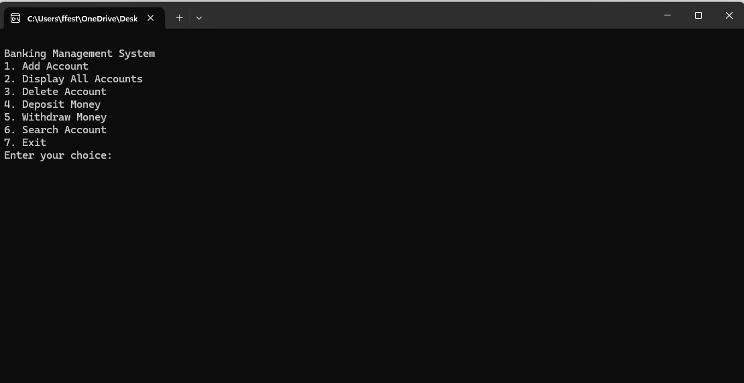


Program Flow & UX
Menu-driven main loop offers choices: Add, Display, Delete, Deposit, Withdraw, Search, Exit. Input validation, formatted table output (iomanip), and graceful memory cleanup on exit.
Add Account
Display All
Modify/Remove
Transactions
Search

Slide 9
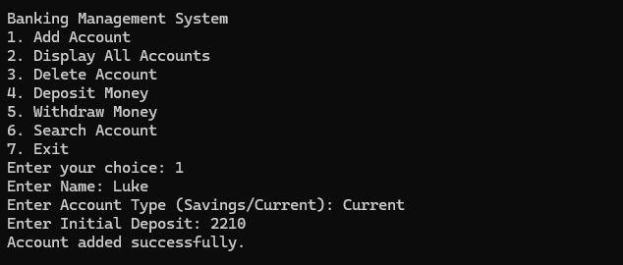
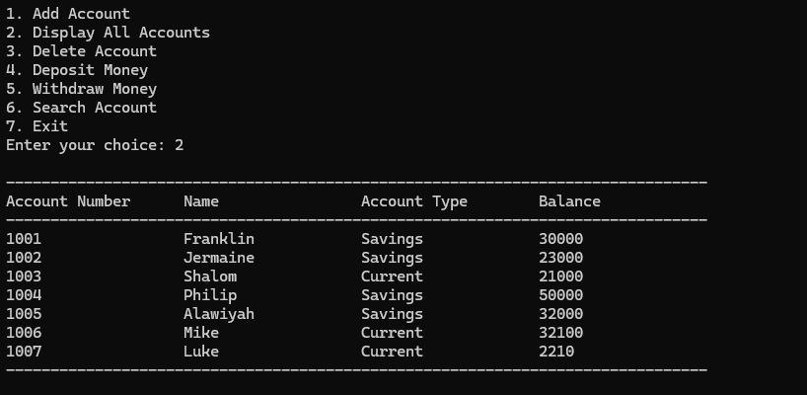
Results, Learning Outcomes & Evidence
The system executes successfully: accounts can be added, modified, searched, deleted, and transactions processed dynamically. Students gained practical skills in linked lists, pointers, modular design, algorithming, and debugging.

Slide 10

Conclusion & Future Work
File Handling
Add data persistence via file I/O.
User Authentication
Implement secure login and access control.
Database Connectivity
Integrate MySQL/SQLite for scalable storage.
GUI & Networking
Develop a graphical interface and enable online transactions.

